Slide 1
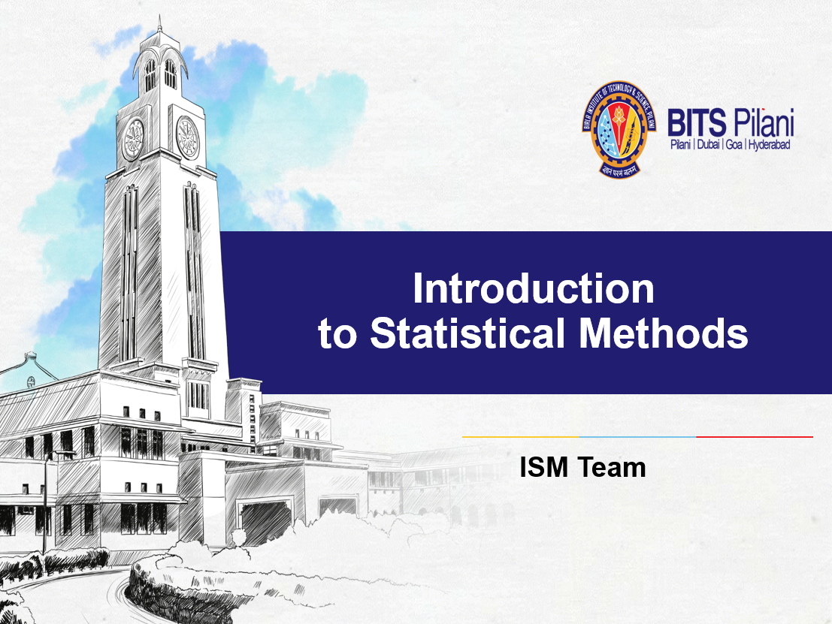

Slide 2

Session No: 9
Testing of Hypothesis
(5th /6th Aug ,2023)

Slide 3
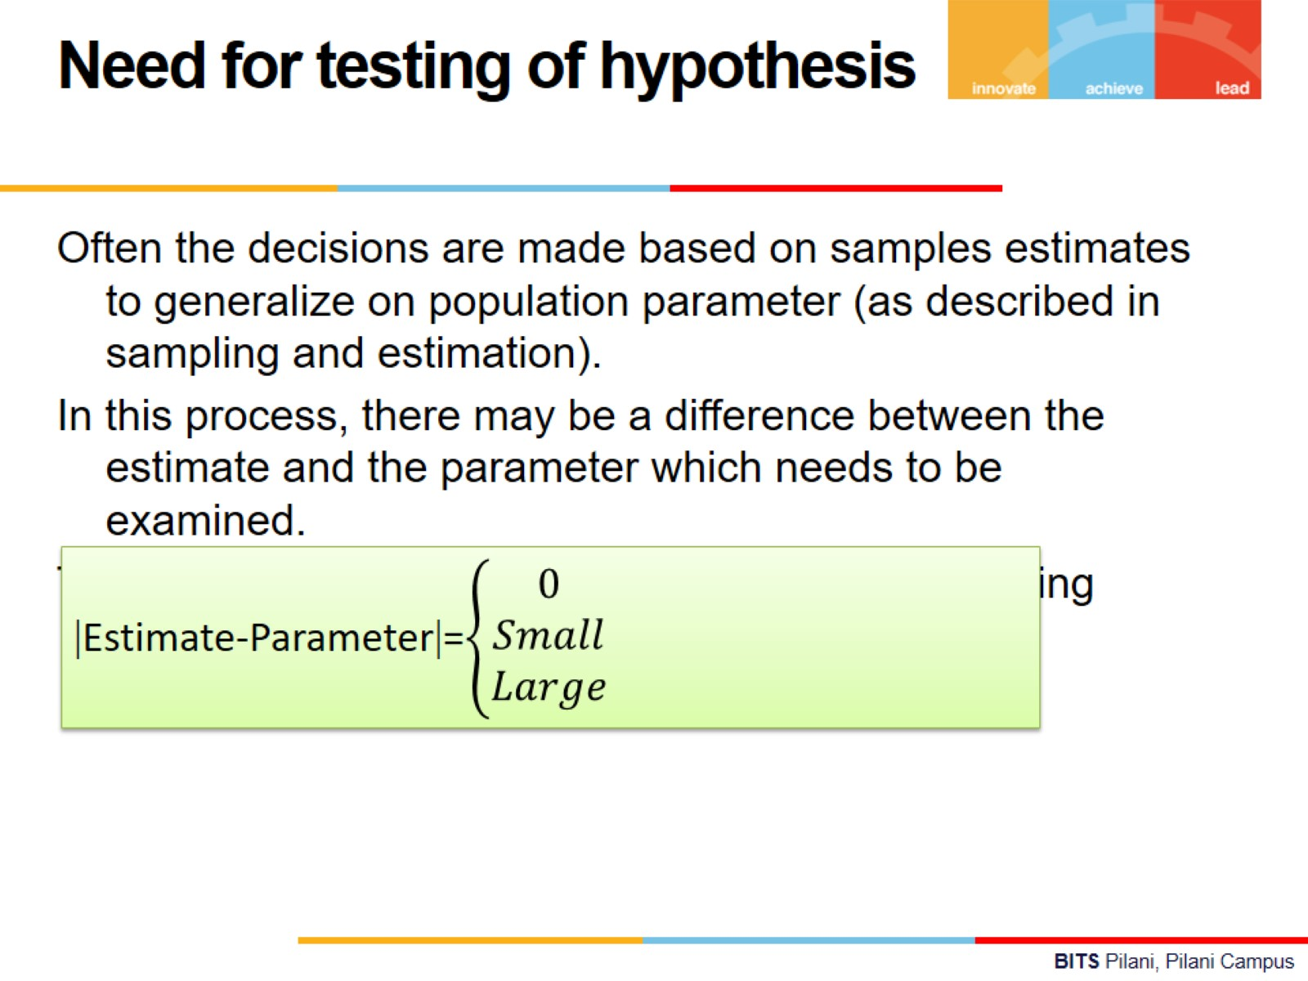
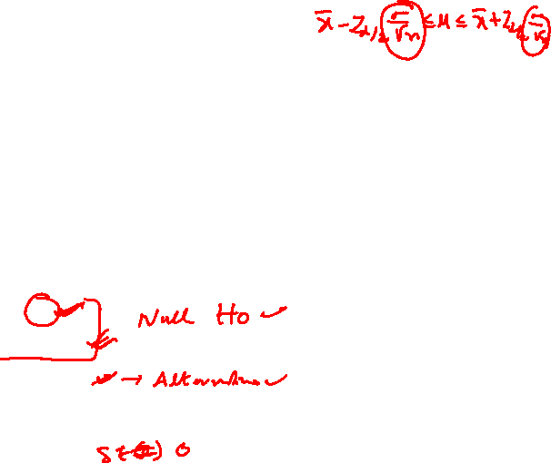

Slide 4
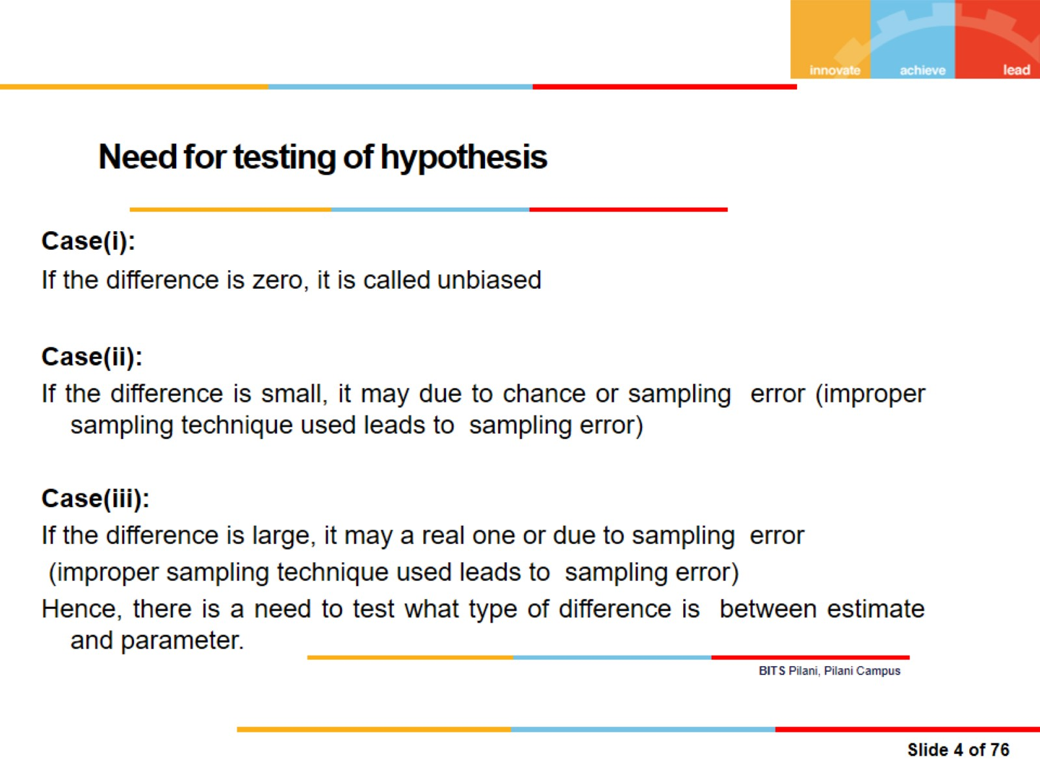

Need for testing of hypothesis

Slide 5
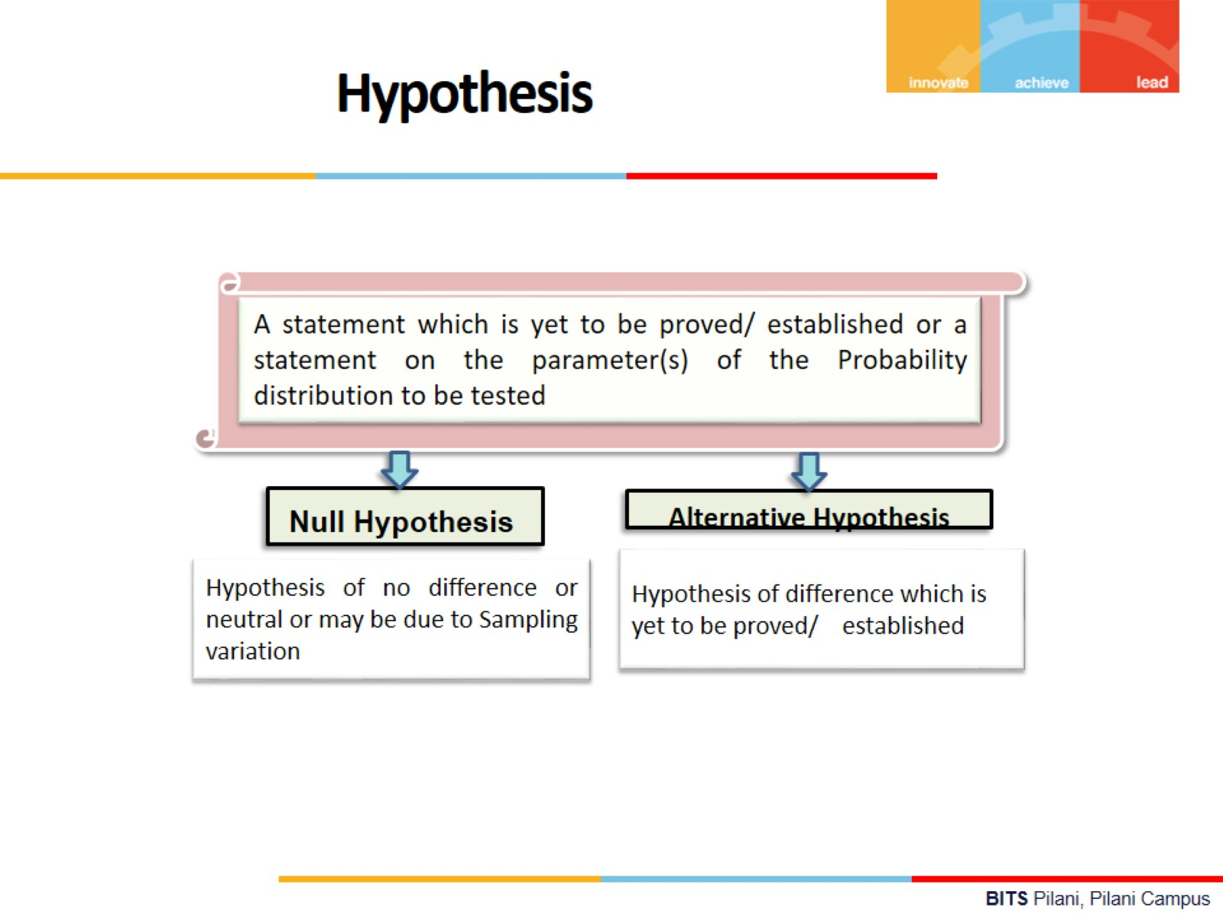
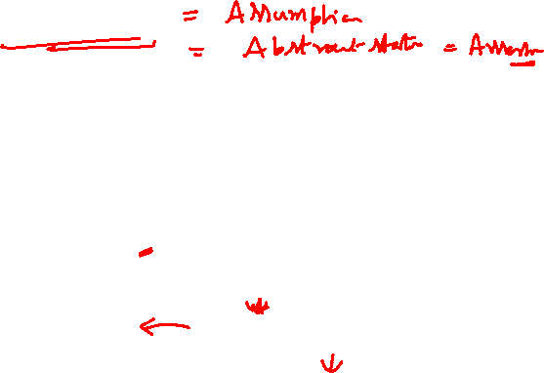

Slide 6

Hypothesis - Formulation
A taxi company manager is trying to decide whether the use of radial tires or regular belted tires improves fuel economy.
Here, the variable fuel consumption measured is quantitative variable.

Slide 7


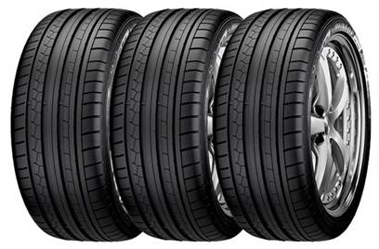

Hypothesis - Formulation
Manager
Regular Tires
Radial Tires
The variable measured fuel consumption
Quantitative

Slide 8



Hypothesis - Formulation
The mean fuel consumption in cars fitted with radial tyres and regular belted tires will be same
The mean fuel consumption in cars fitted with regular tyres may be less than radial belted tires

Slide 9

Hypothesis - Formulation
The mean fuel consumption in cars fitted with regular tires may be more than radial belted tires
The mean fuel consumption in cars fitted with regular tires and radial belted tires may be different

Slide 10
Test

Slide 11
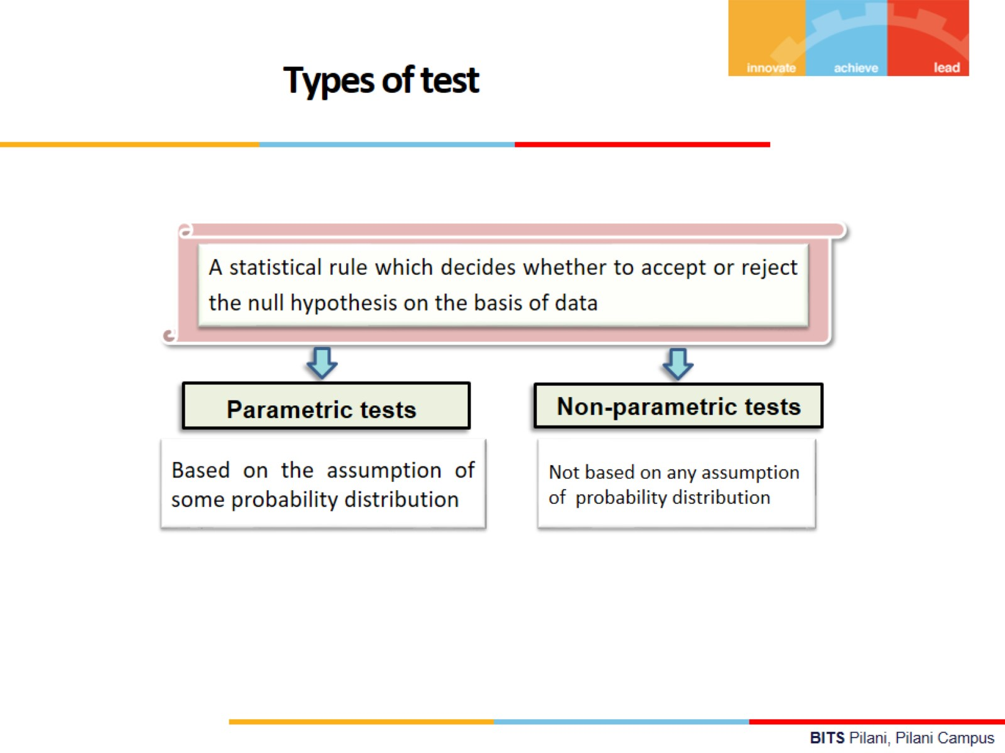

Slide 12
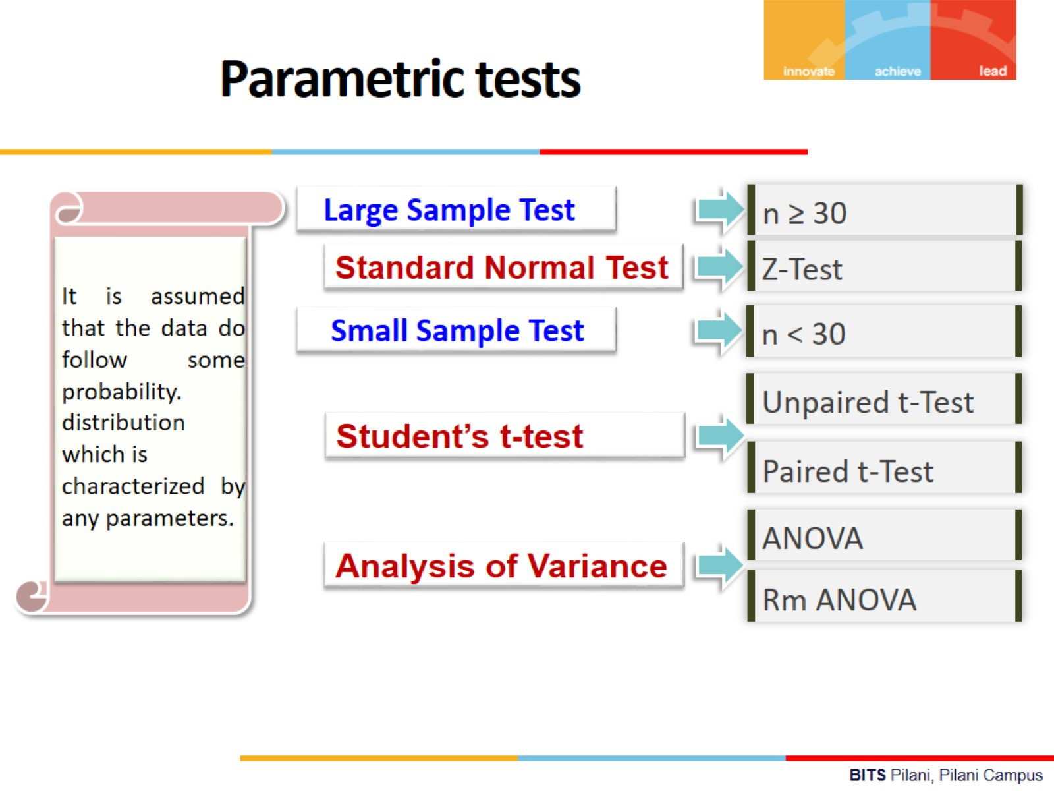


Slide 13
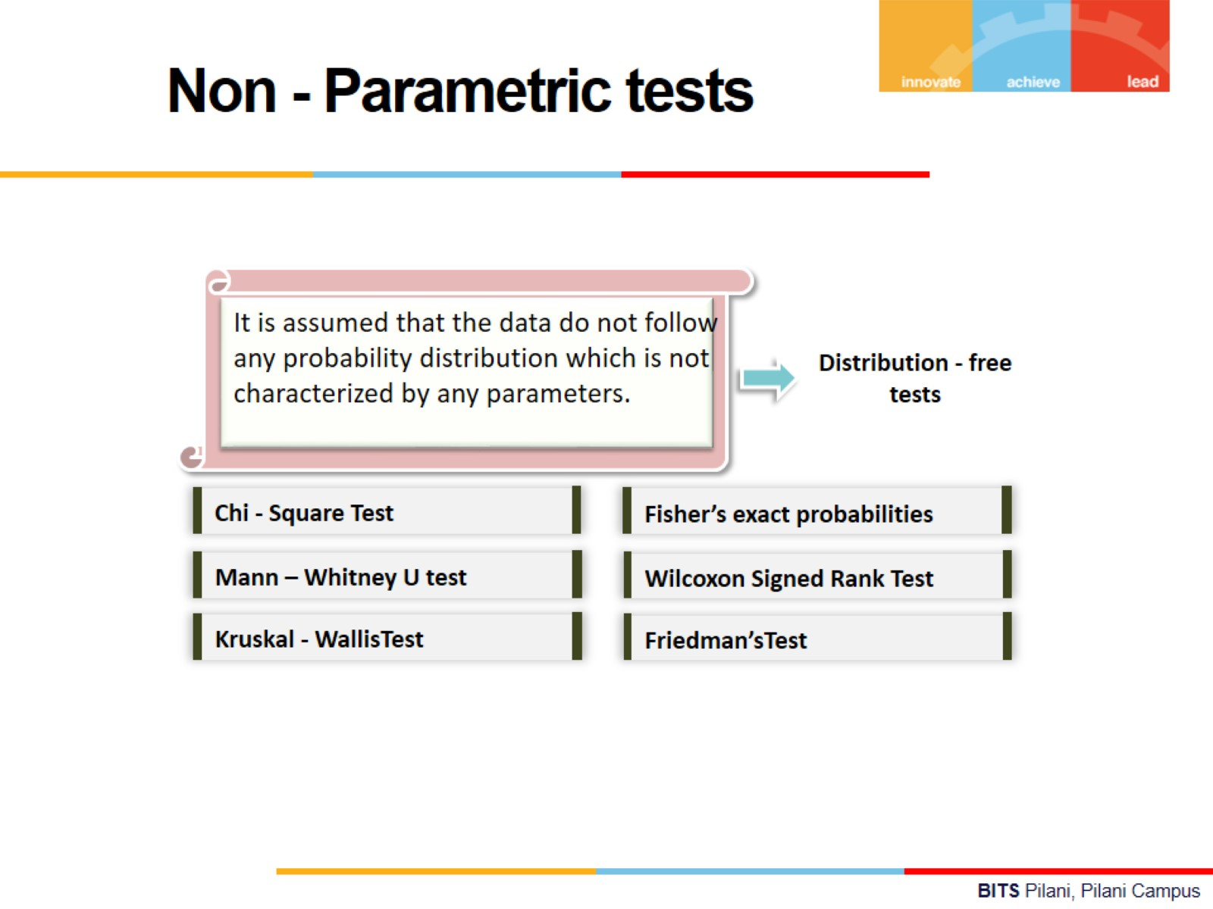


Slide 14
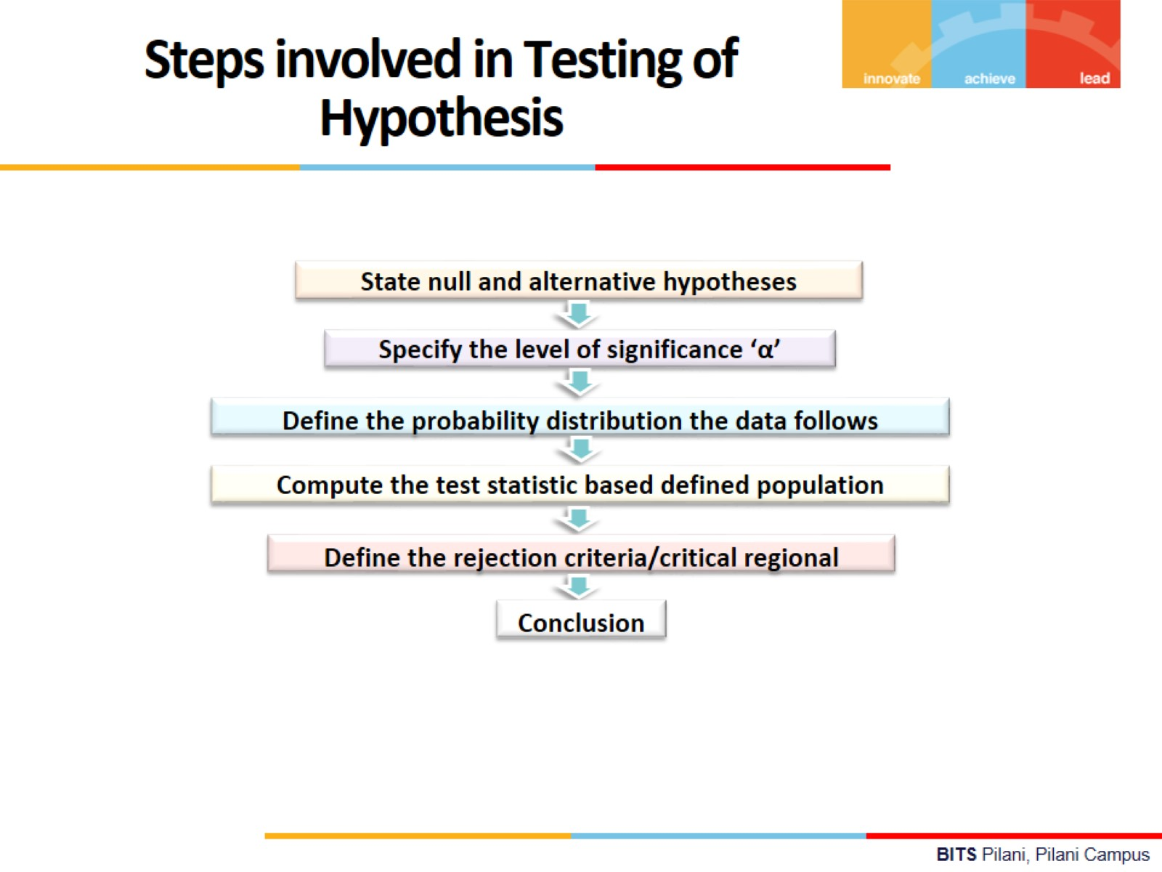
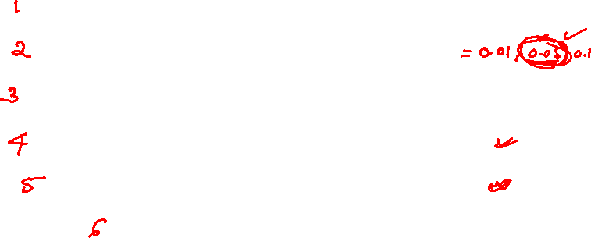

Slide 15
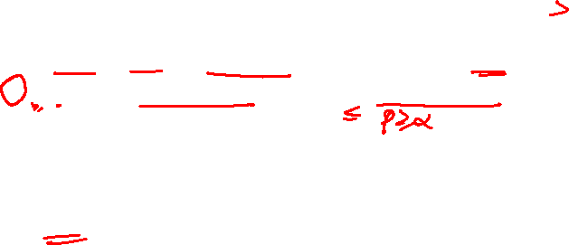
Conclusion Process
For one tailed test:
If the modulus of calculated value of the test statistic is more than the critical or significant value(table value) of test statistic at alfa level of significance or
P< alfa then H0 is rejected otherwise H0 is accepted.
For two tailed test:
If the modulus of calculated value of the test statistic is more than the critical or significant value(table value) of test statistic at (alfa)/2 level of significance or
P< (alfa)/2 then H0 is rejected otherwise H0 is accepted.

Slide 16


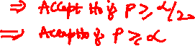

P – value: The strength of the evidence of the null hypothesis that the true difference between estimate and parameter is zero.
P= P(Statistic>|computed value|)
If P is very small then H0 is rejected indicating no enough evidence to support H0 and there is enough evidence to support H1 otherwise, H0 is accepted.
For two tailed test, Reject H0 if P< (Alfa)/2.
For One tailed test, Reject H0 if P< Alfa.

Slide 17
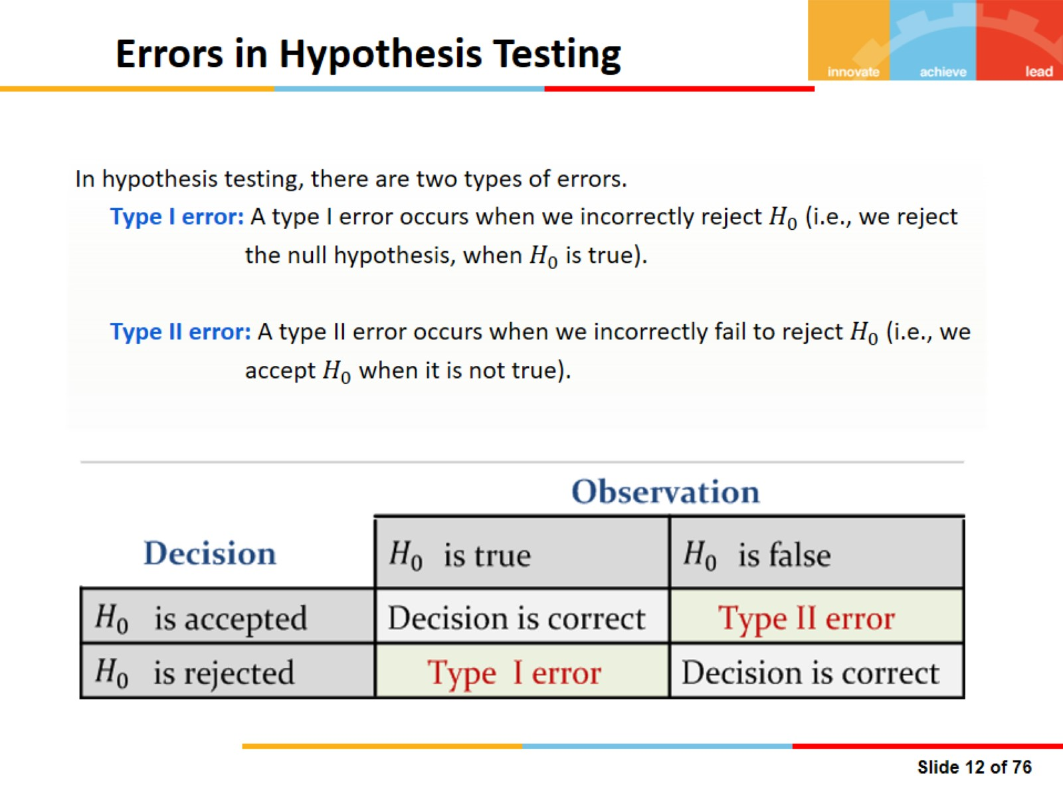
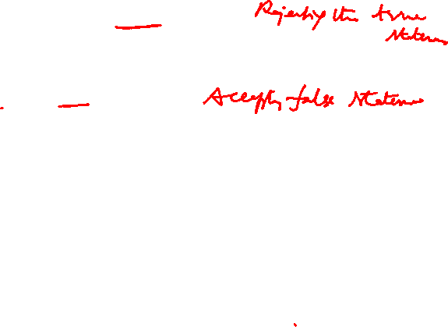

Slide 18
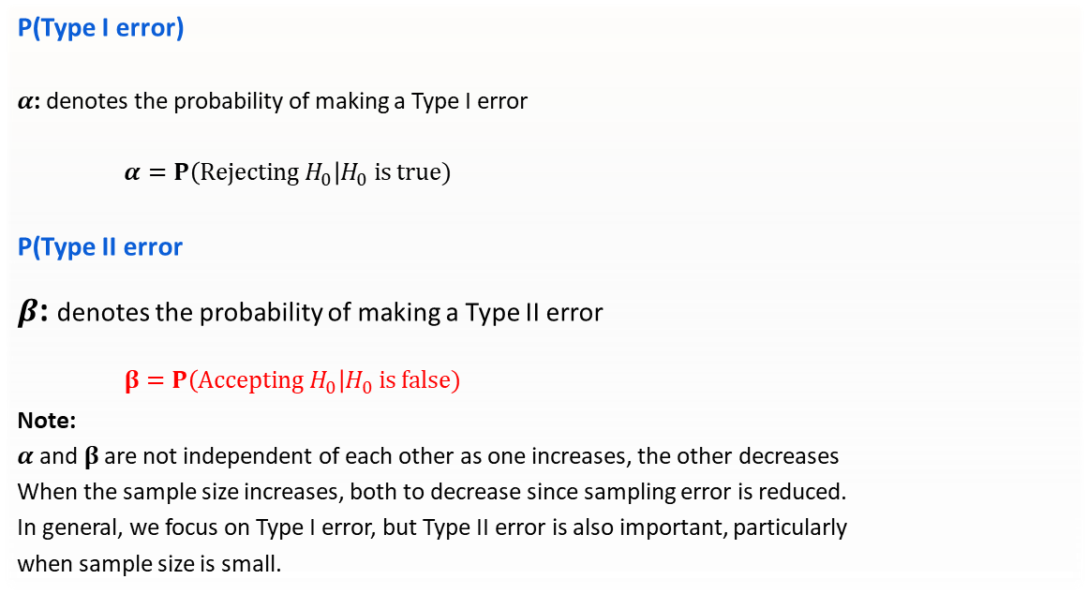
Errors in Hypothesis Testing
P(Type I error)
$α$: denotes the probability of making a Type I error
$α=P\left(Rejecting H_{0}\right|H_{0} is true)$
P(Type II error
$β$: denotes the probability of making a Type II error
$β=P\left(Accepting H_{0}\right|H_{0} is false)$
Note:
$α$ and $β$ are not independent of each other as one increases, the other decreases
When the sample size increases, both to decrease since sampling error is reduced.
In general, we focus on Type I error, but Type II error is also important, particularly
when sample size is small.

Slide 19
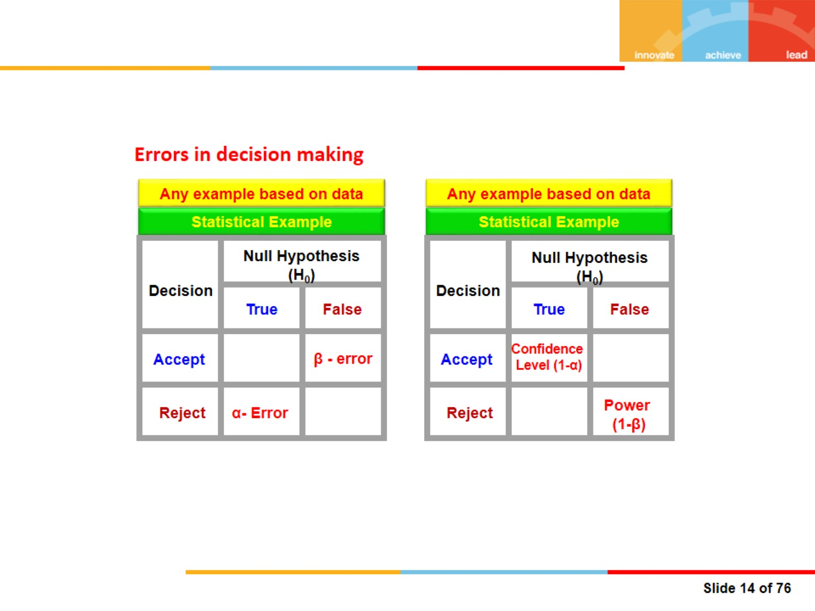
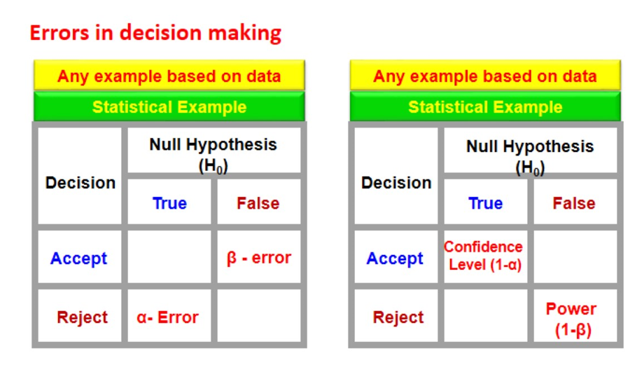
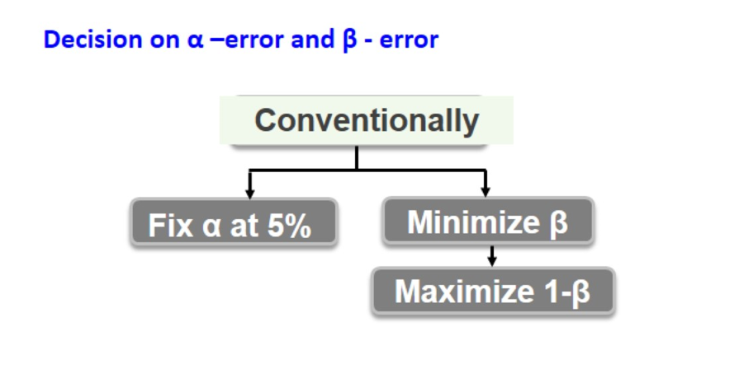

Errors in decision making

Slide 20
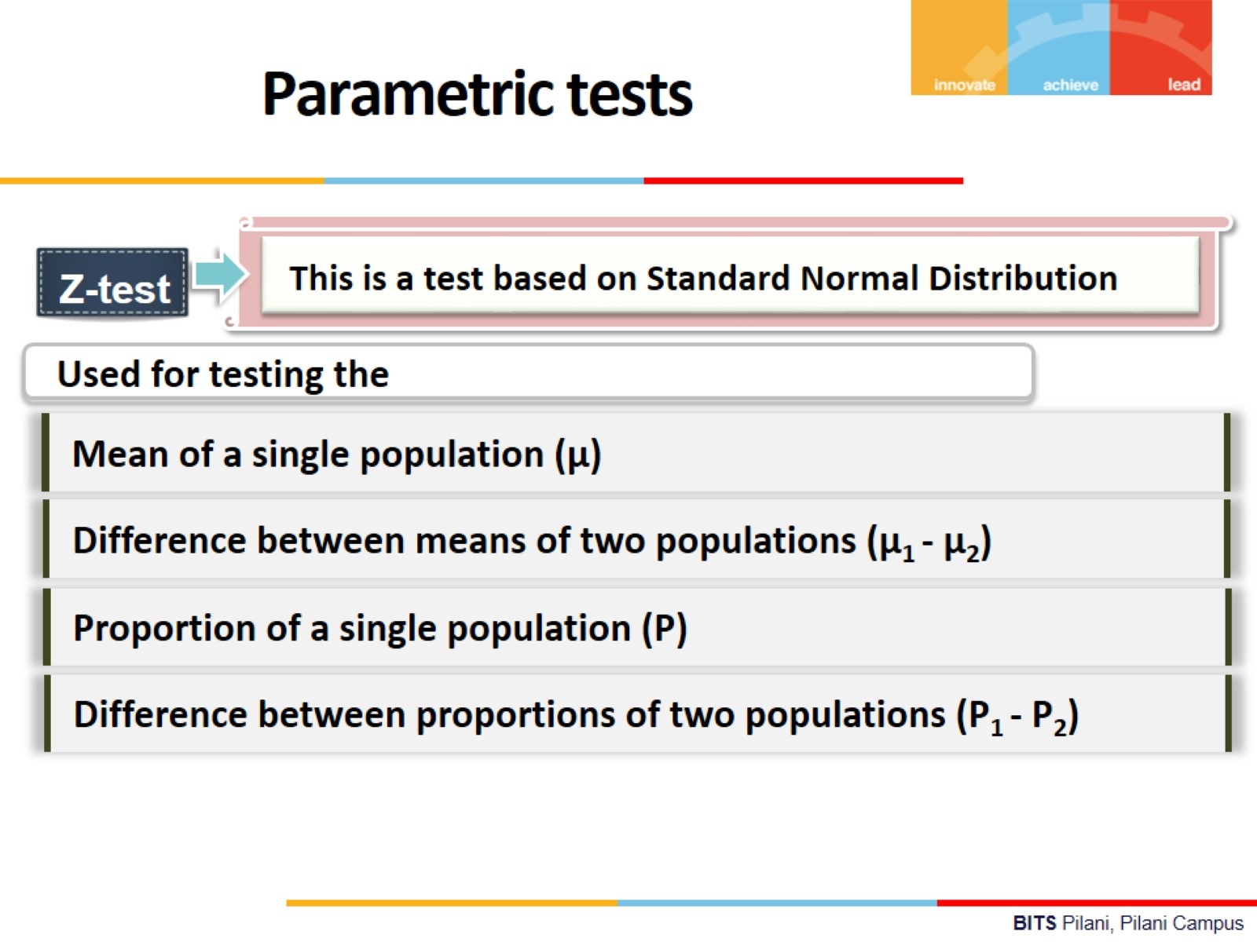

Slide 21
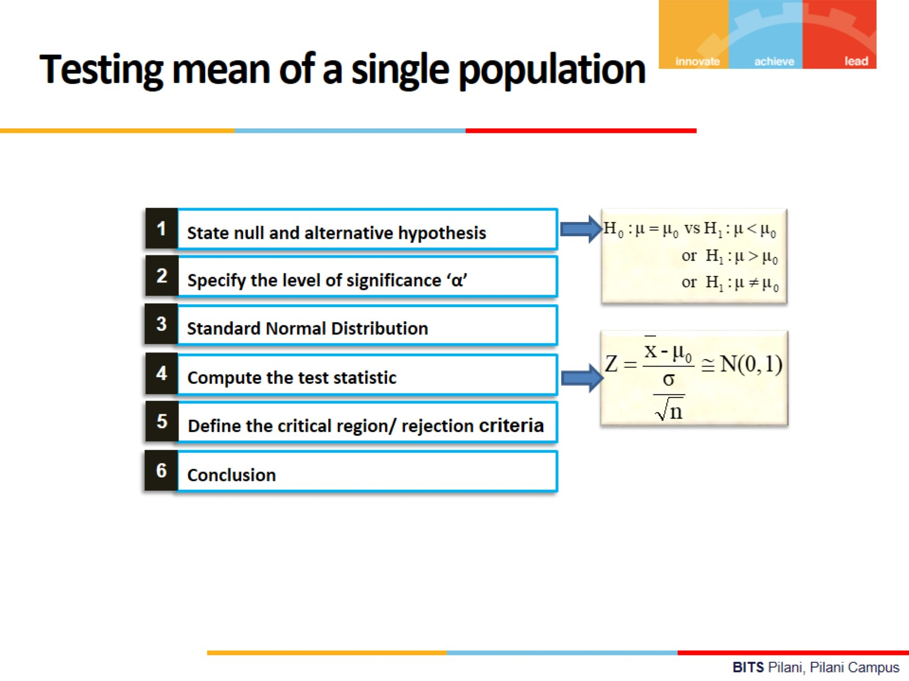


Slide 22
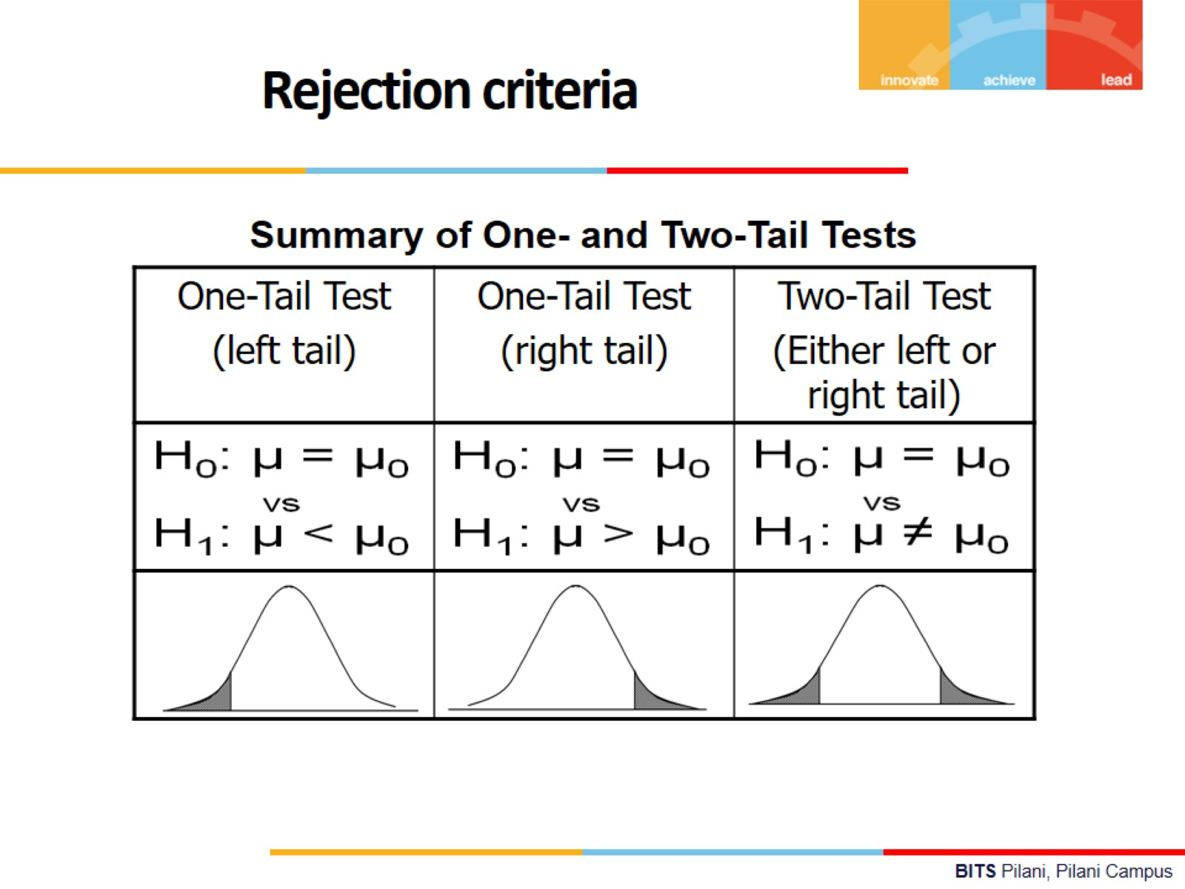

Slide 23


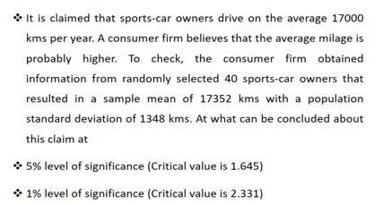
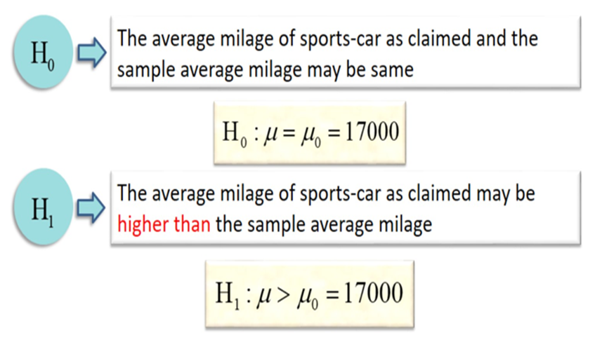
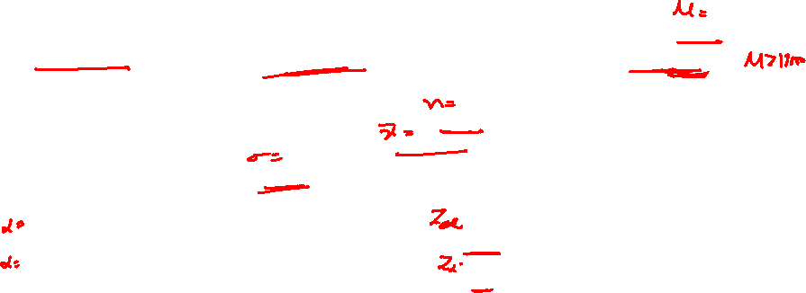

Slide 24
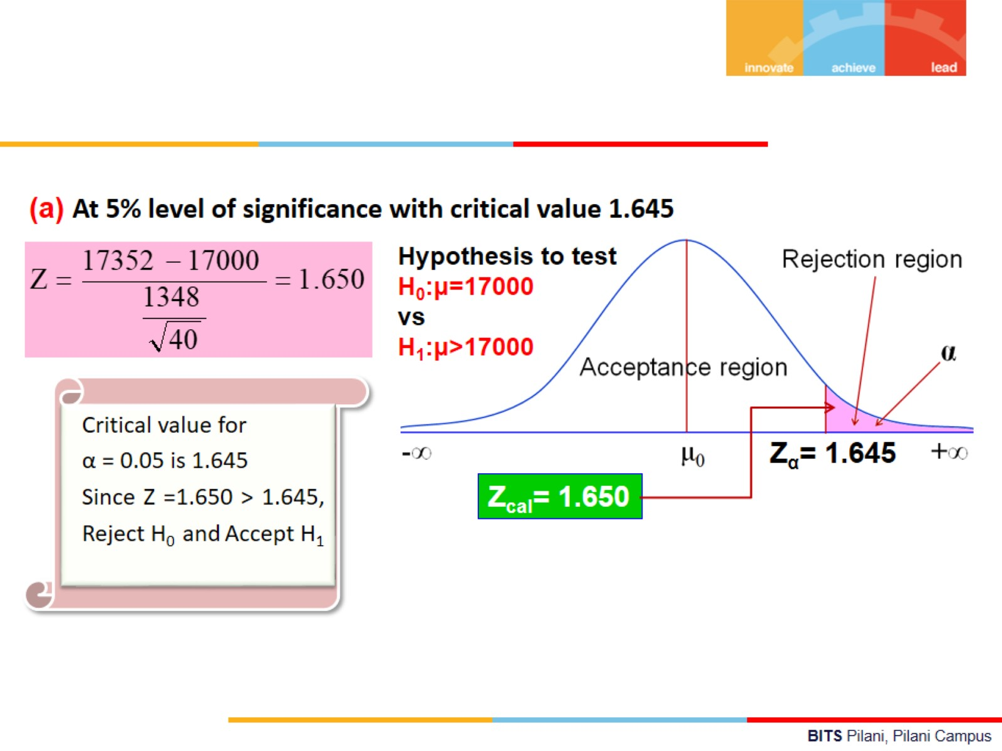
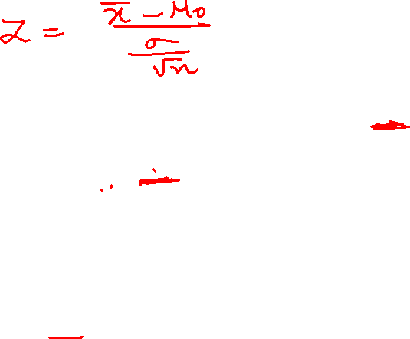

Slide 25
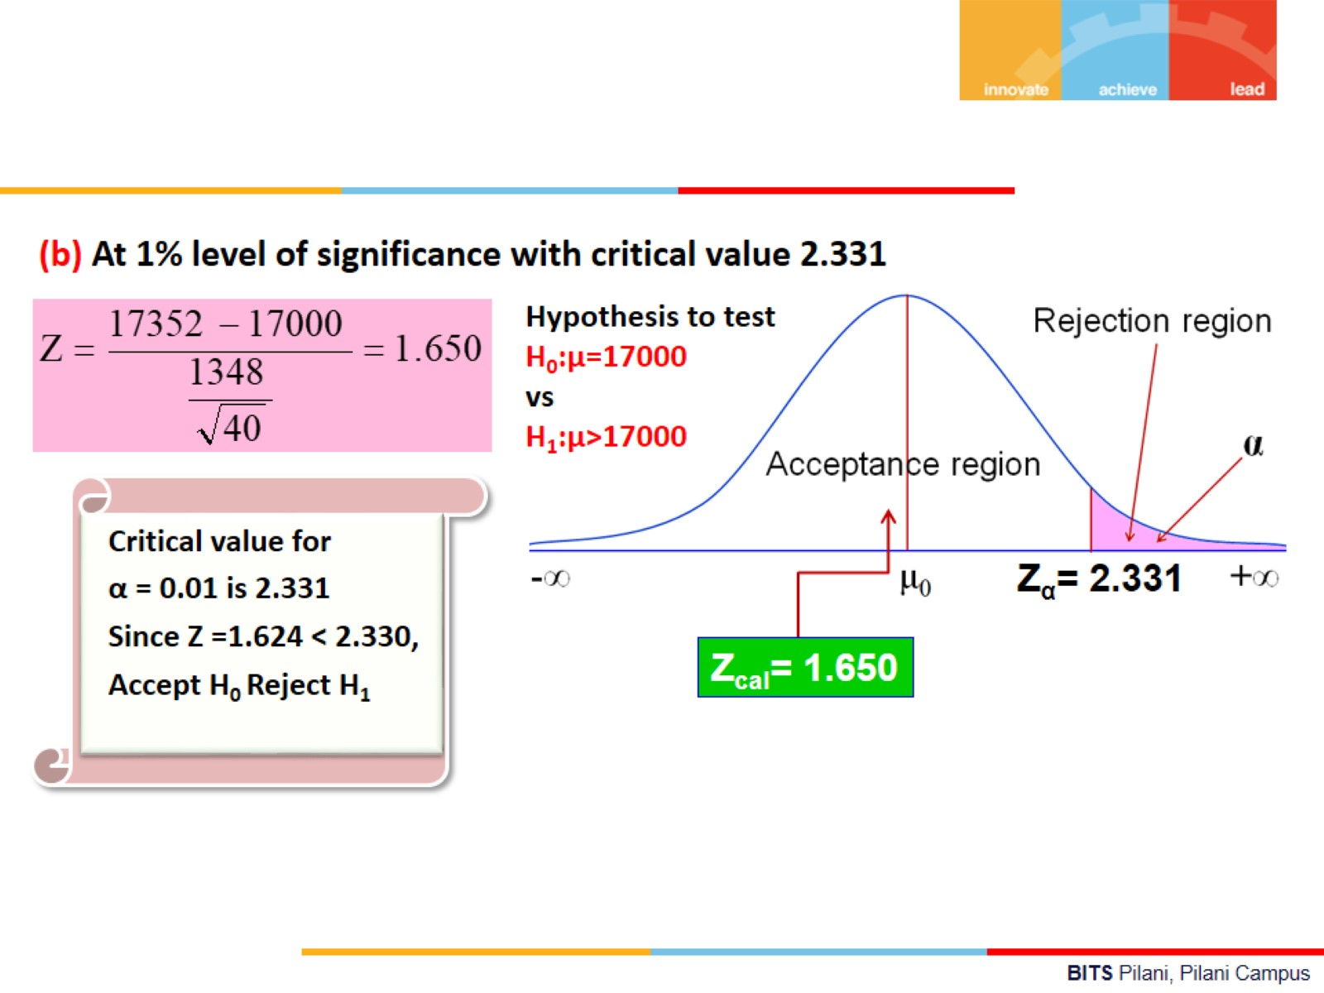


Slide 26
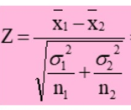
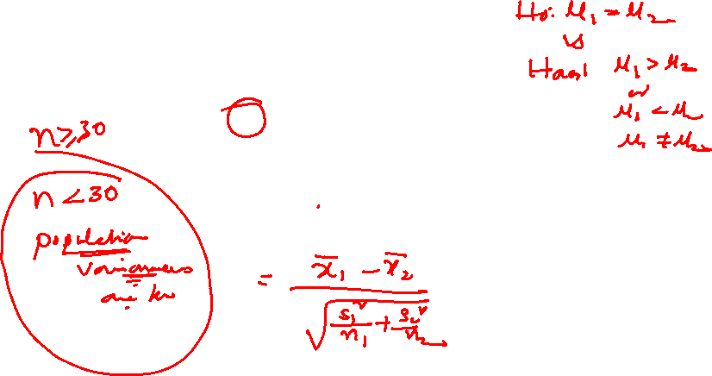
Test of Difference of two means

Slide 27

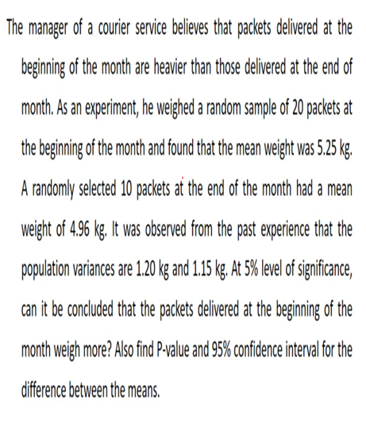
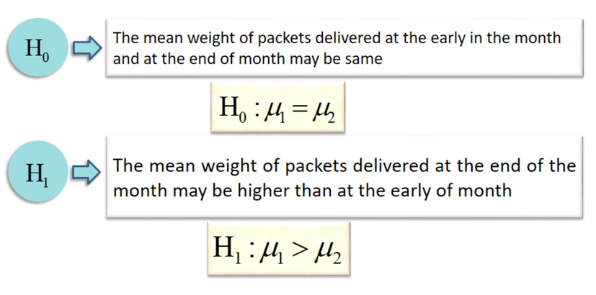
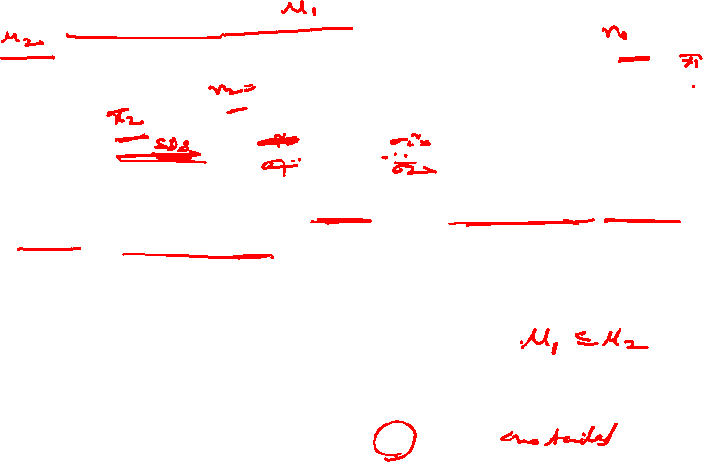
Example:2

Slide 28
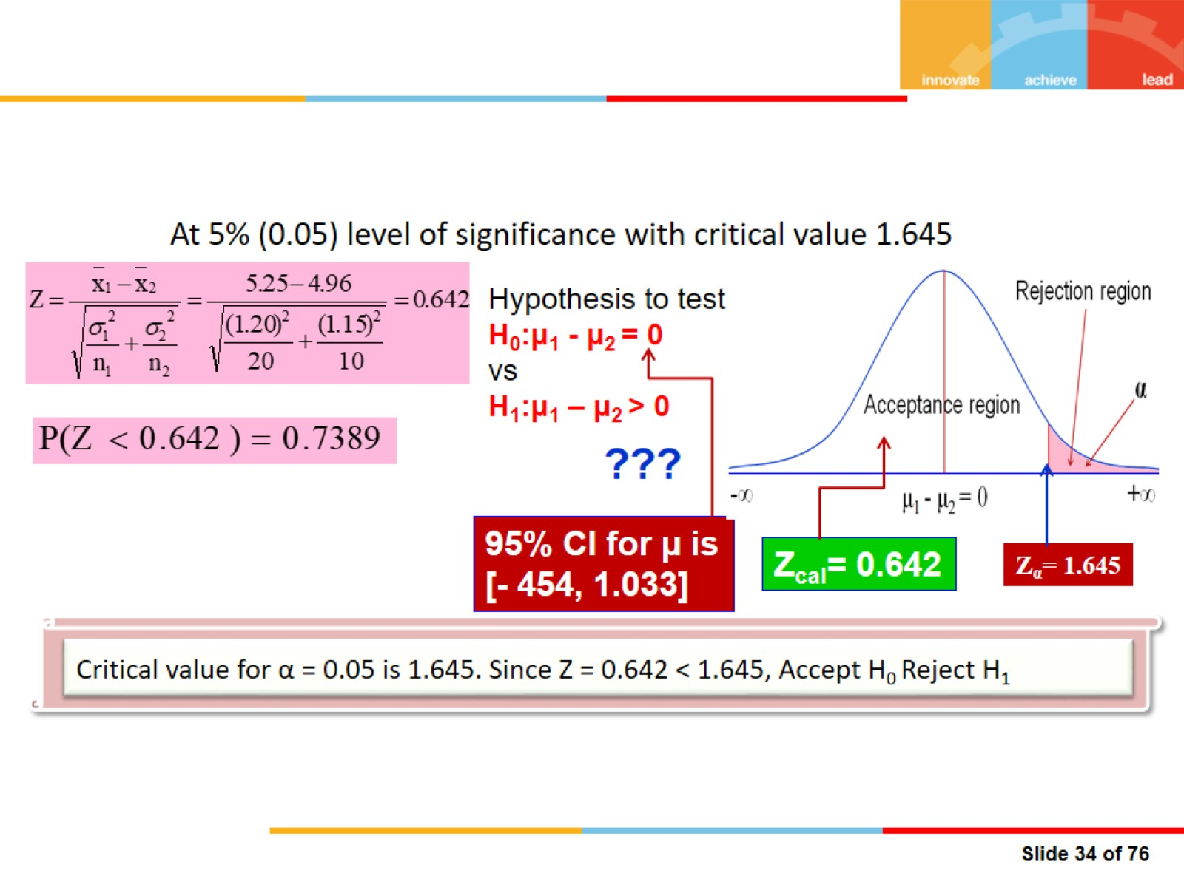
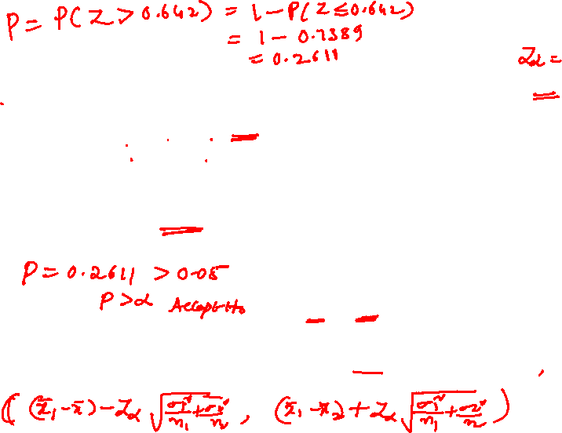

Slide 29
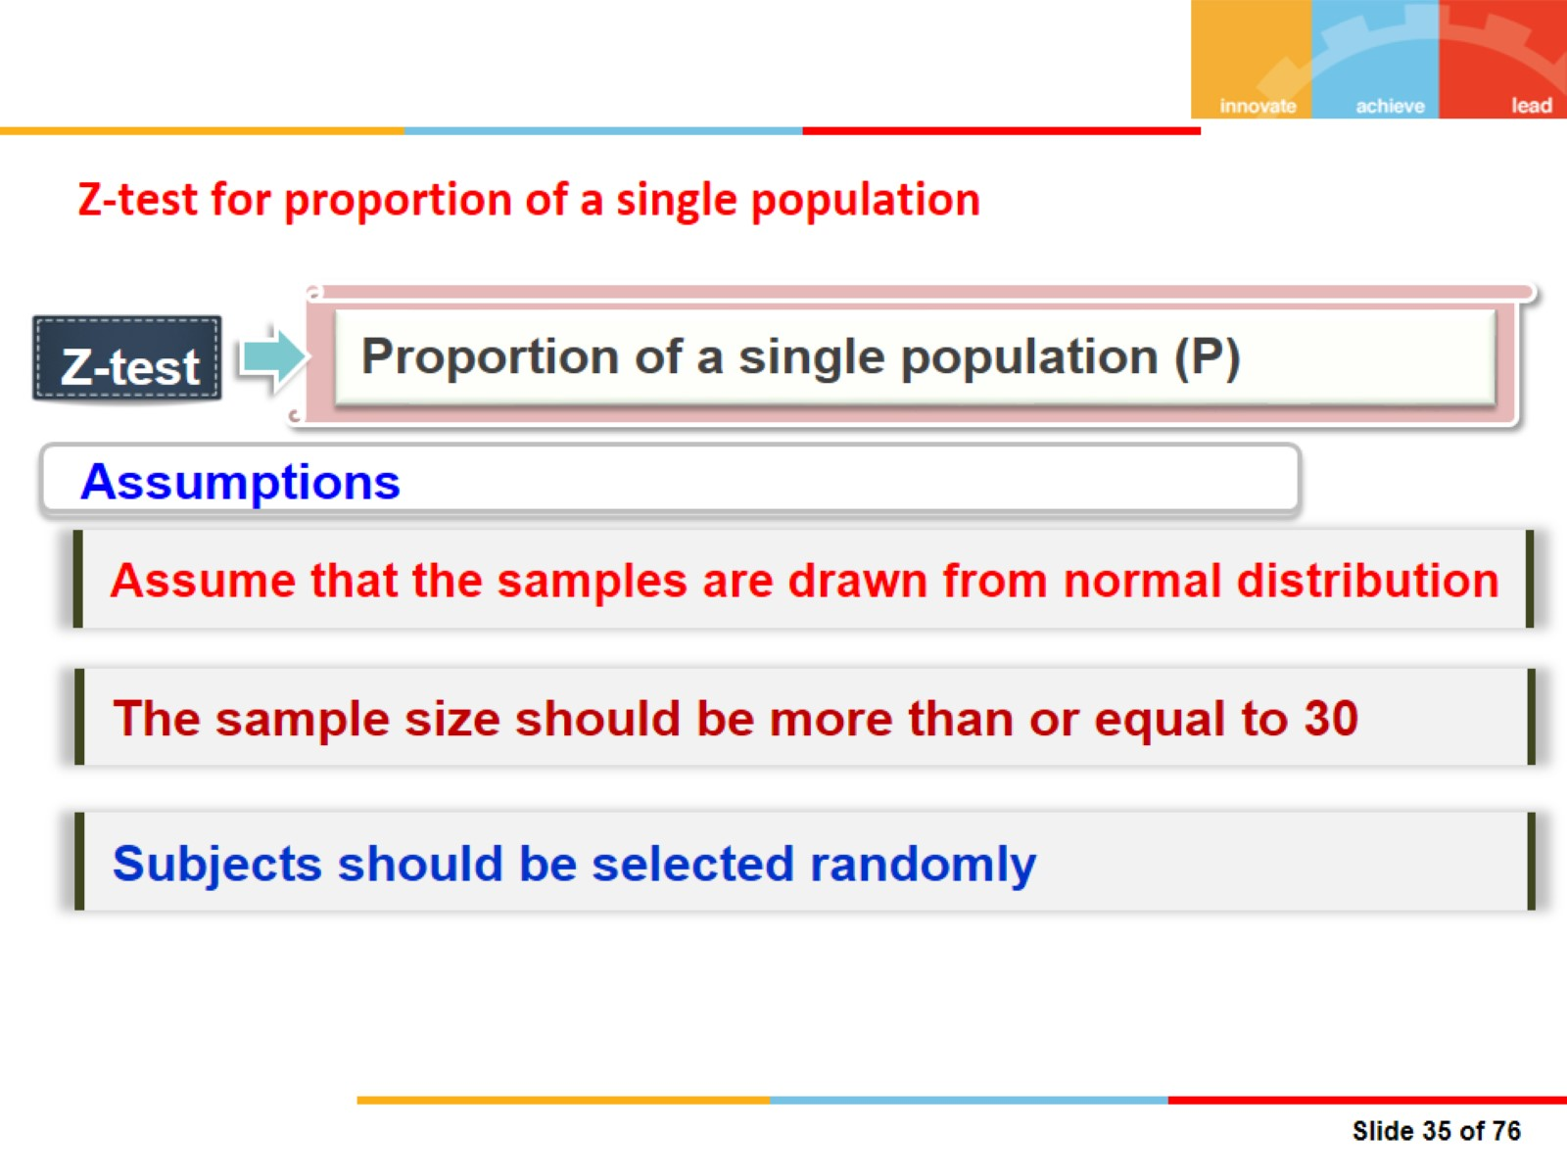
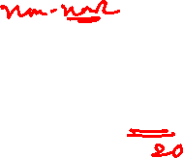
Z-test for proportion of a single population

Slide 30
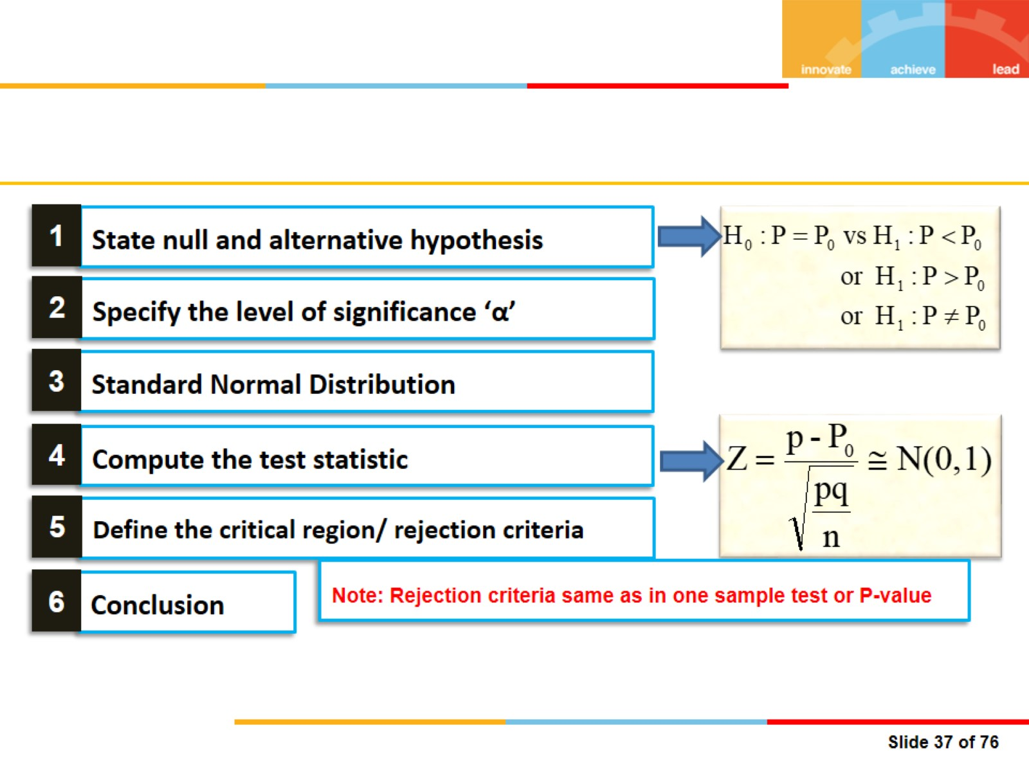


Slide 31


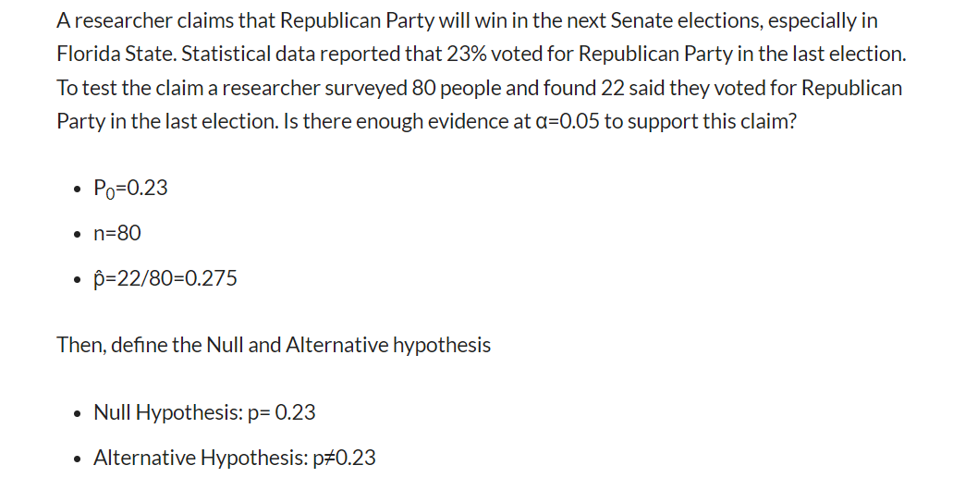
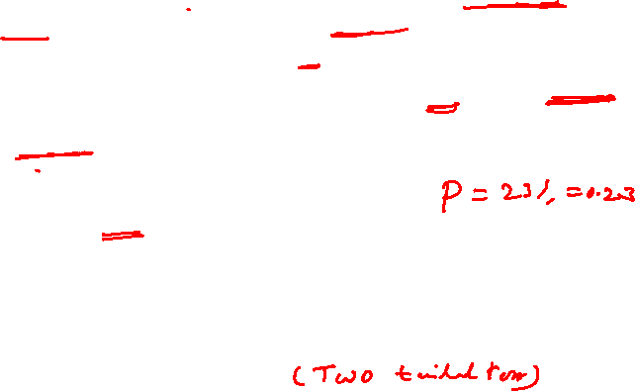

Slide 32
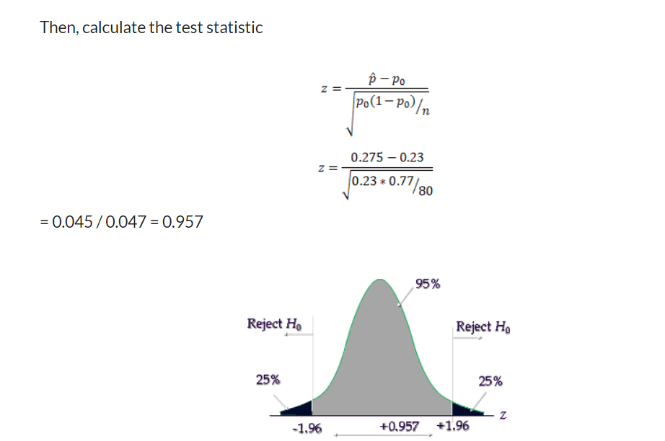
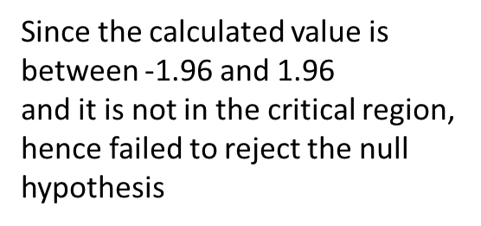

Slide 33
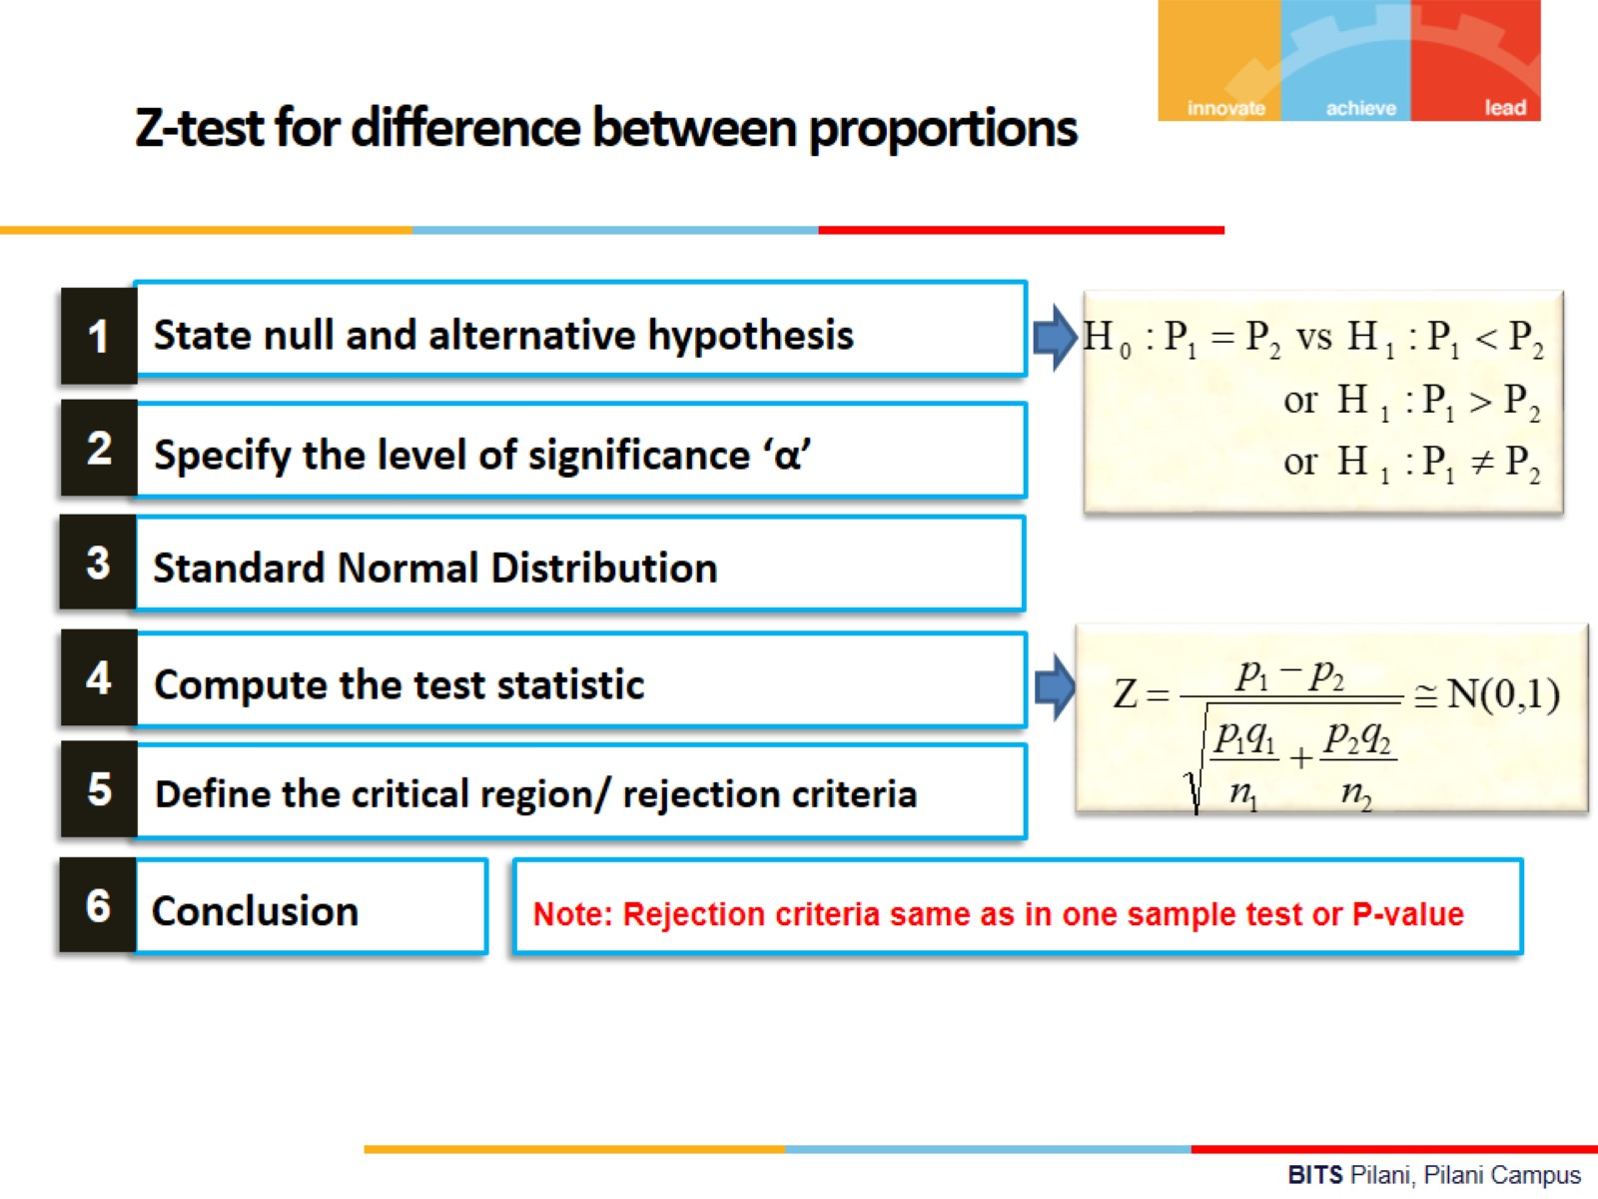

Slide 34
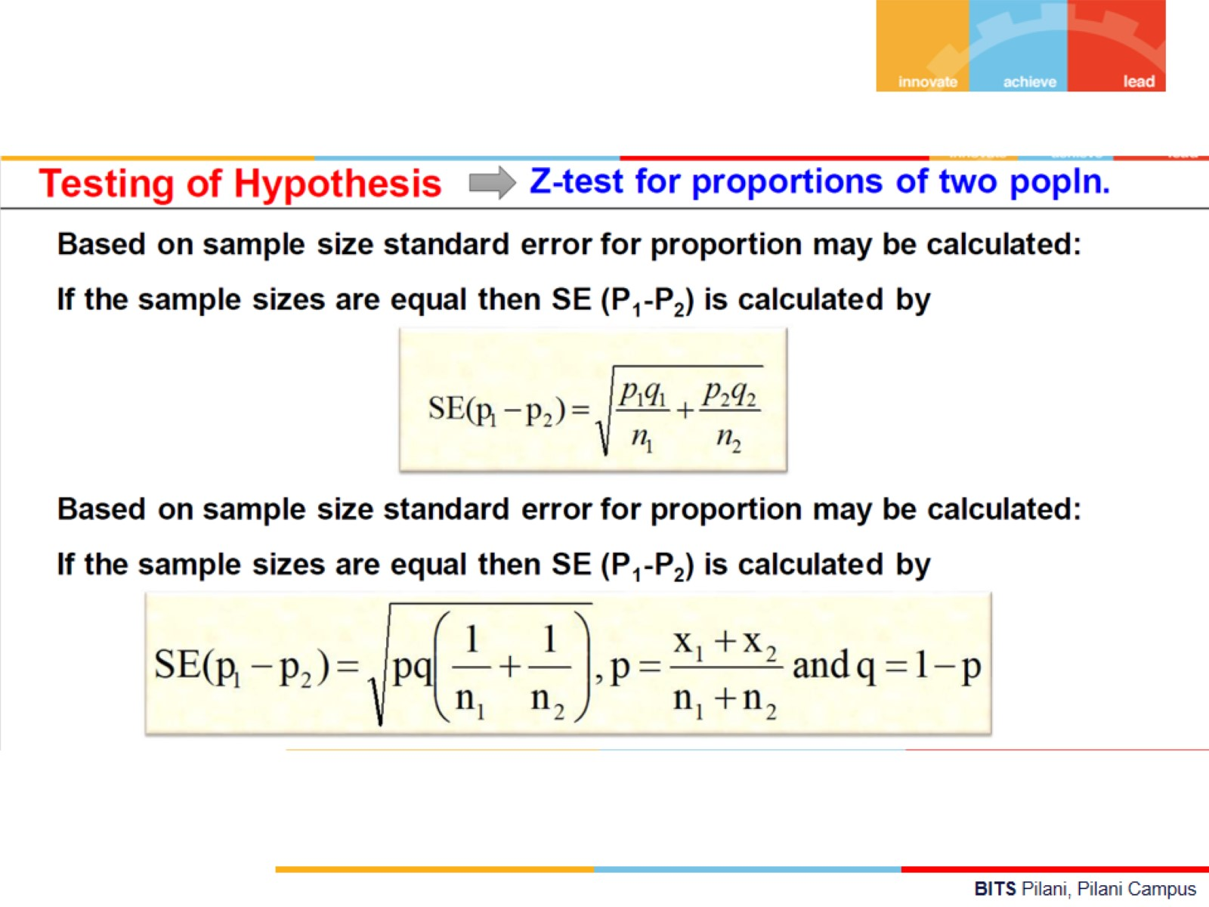

Slide 35
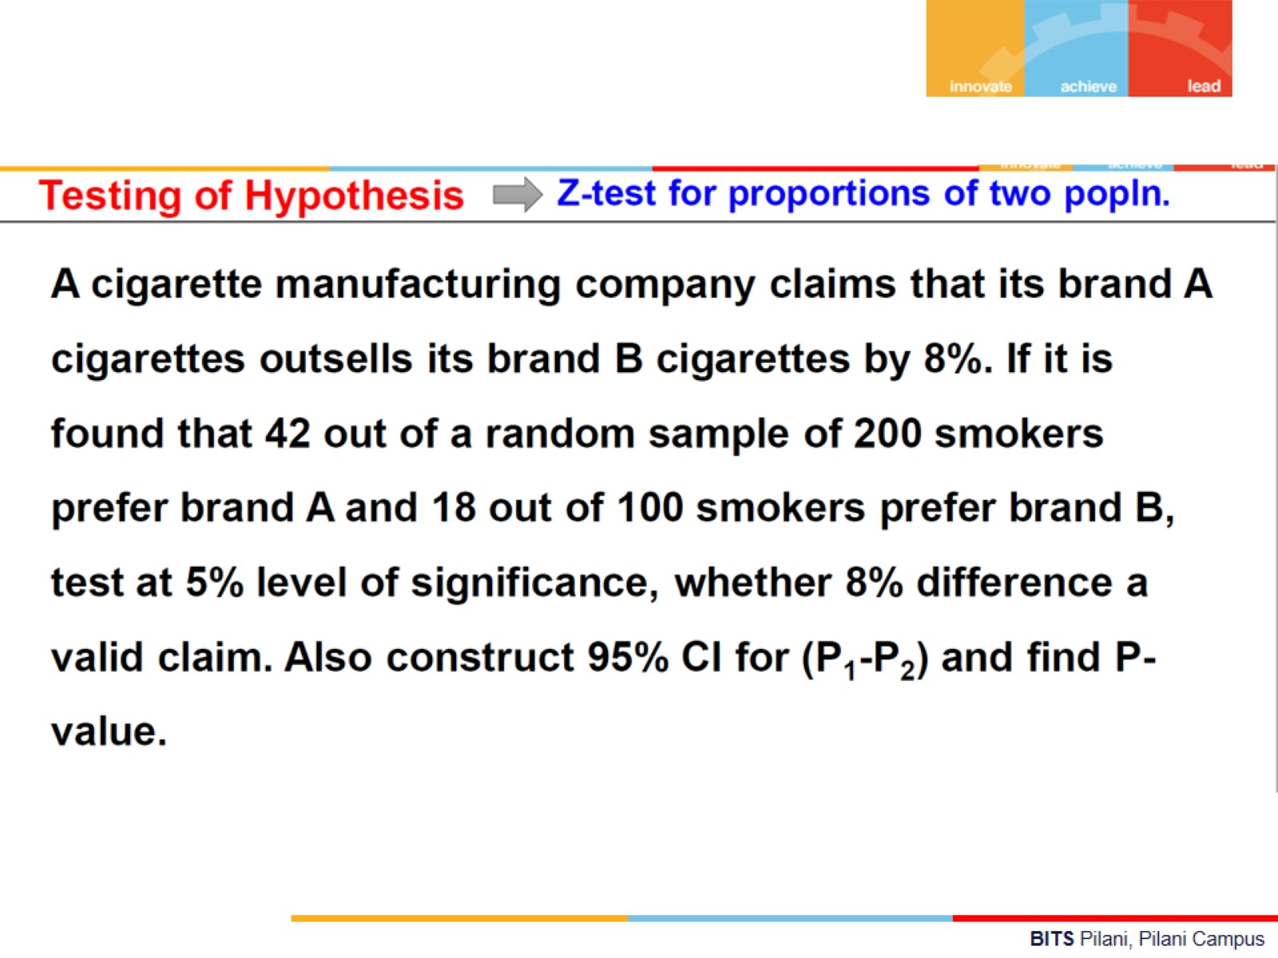

Slide 36
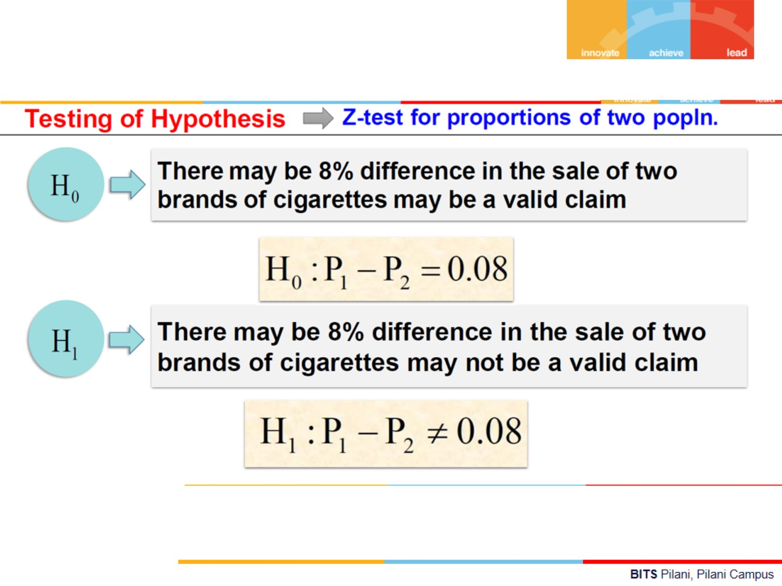

Slide 37
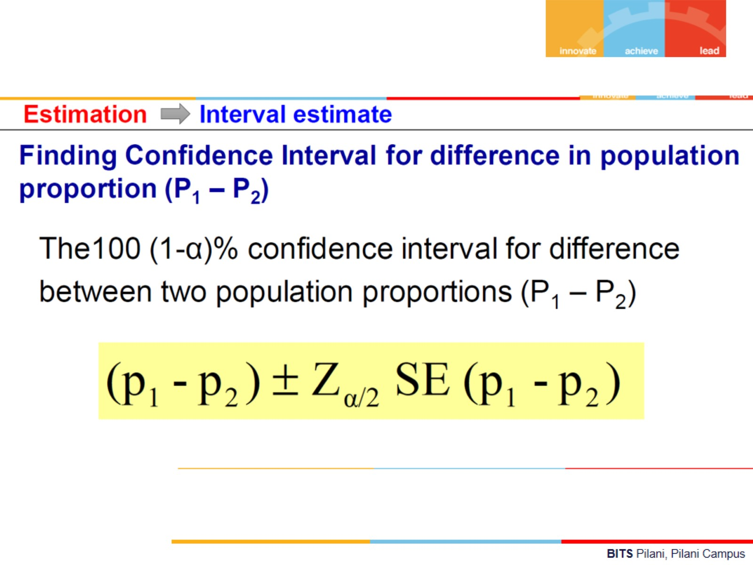

Slide 38
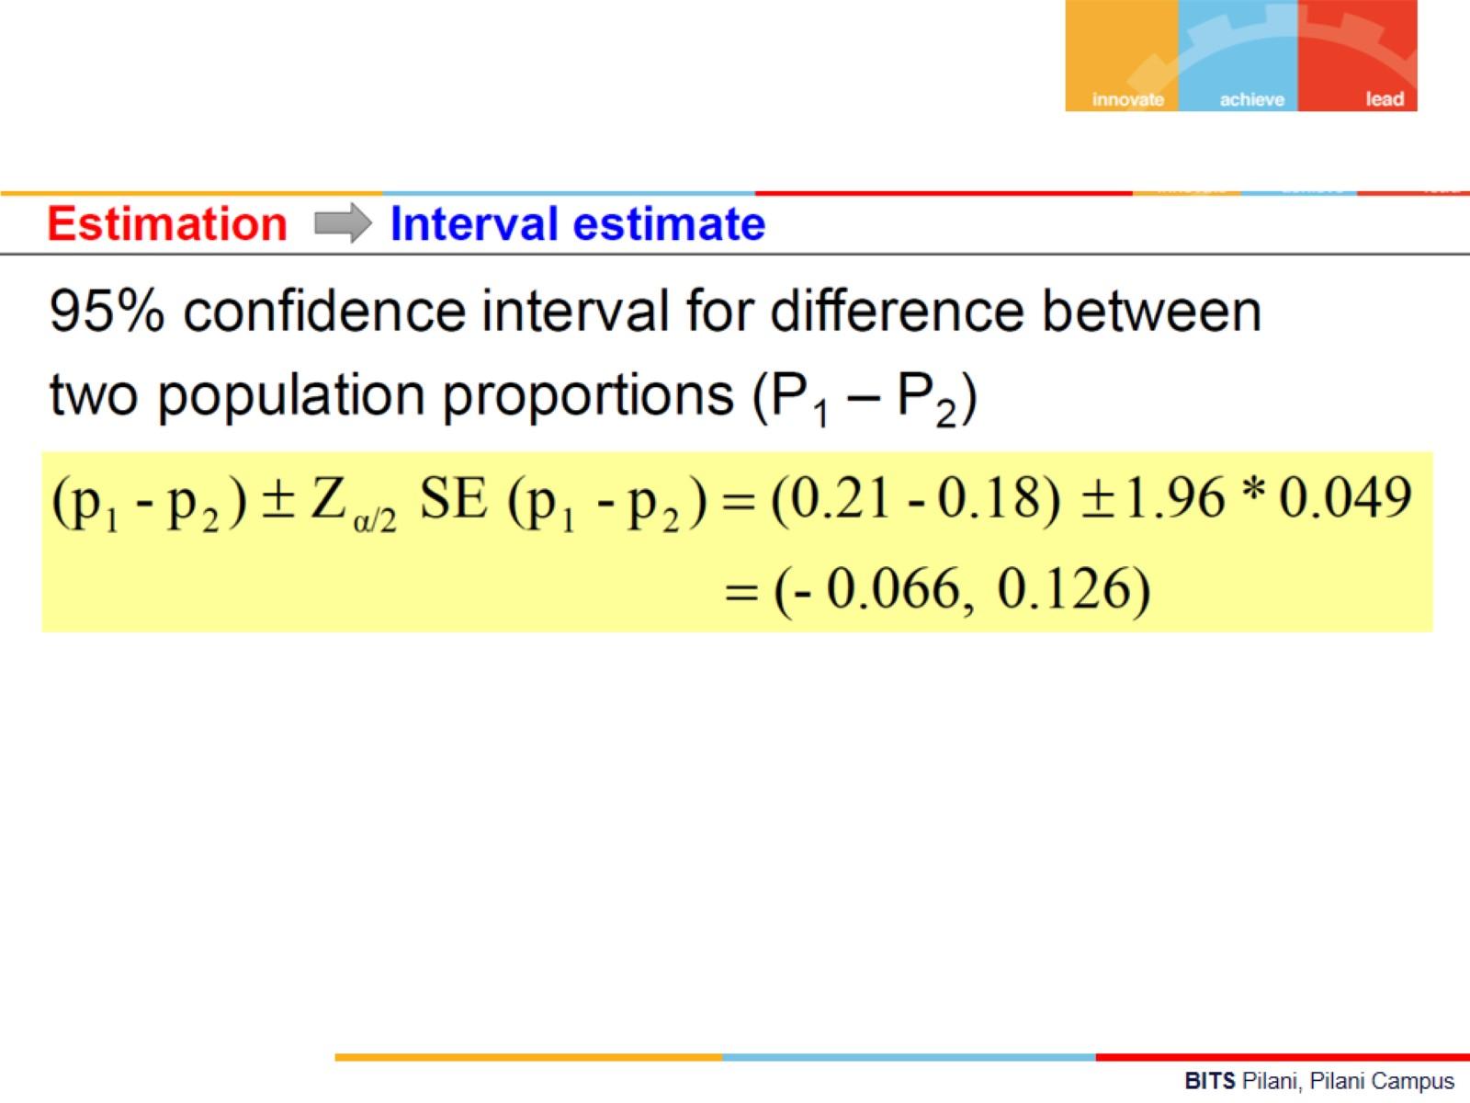

Slide 39
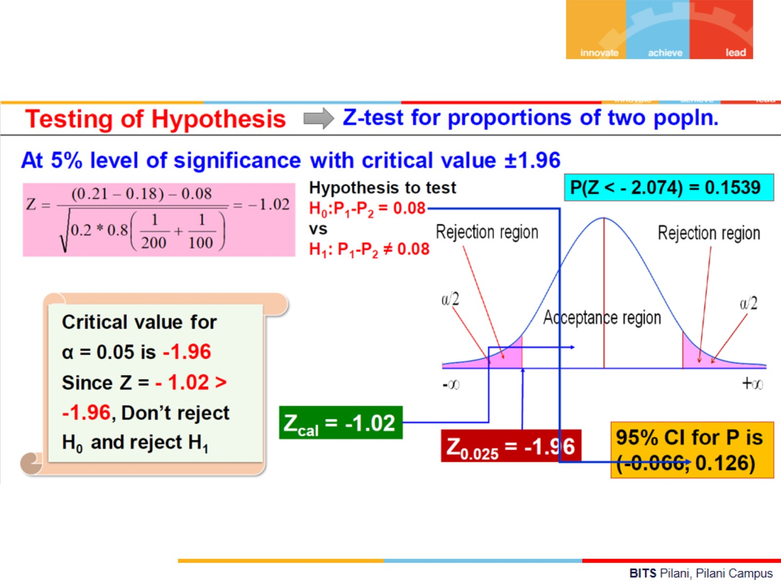

Slide 40



Slide 41


Example

Slide 42


Slide 43


Slide 44




Slide 45


Slide 46


Slide 47


Slide 48


Slide 49








Slide 50



Slide 51


Slide 52


Slide 53


Slide 54


Slide 55


Slide 56


Slide 57


Slide 58


Slide 59


Slide 60


Slide 61


Slide 62


Slide 63

Chi-Square Test of Goodness of Fit between Observation and Expectation
Follows chi-square distribution with (k-1) degree of freedom

Slide 64

Problem

Slide 65


Slide 66


Slide 67


Slide 68

Exercise Questions
This Photo by Unknown Author is licensed under CC BY-SA

Slide 69


Slide 70


Slide 71


Slide 72

Example

Slide 73

Example

Slide 74

Example

Slide 75


Slide 76


Slide 77


Slide 78


Slide 79

Example

Slide 80


Slide 81


Slide 82


Slide 83


Slide 84


Slide 85


Slide 86


Slide 87


Slide 88


Slide 89


Slide 90


Slide 91


Slide 92


Slide 93


Slide 94


Slide 95


Slide 96


Slide 97


Slide 98


Slide 99


Slide 100


Slide 101


Slide 102


Slide 103

P-value

Slide 104


Slide 105


Slide 106

Problem-1

Slide 107

Problem
2

Slide 108

Problem
3

Slide 109

Problem 5

Slide 110

Problem
5

Slide 111

Problem
6

Slide 112

Problem
7

Slide 113


Slide 114

Thanks

